Slide 1
Aerospike and Conventional Bell-Shaped Nozzles: A Numerical Comparison of High-Powered Sounding Rocket Flight Profiles
Presenter: Peter Renslow
Advisors: James K. Villarreal and Steven Shark

Slide 2
Rocket Nozzle Theory
Rocket thrust is dependant on two things:
The mass flow rate of propellant being ejected from the nozzle
The difference in ambient air pressure and nozzle exit pressure
The Thrust Equation:
Pressure Differential Component
Mass flow rate component
Thrust is maximized when the nozzle exit pressure equals the ambient pressure

Slide 3
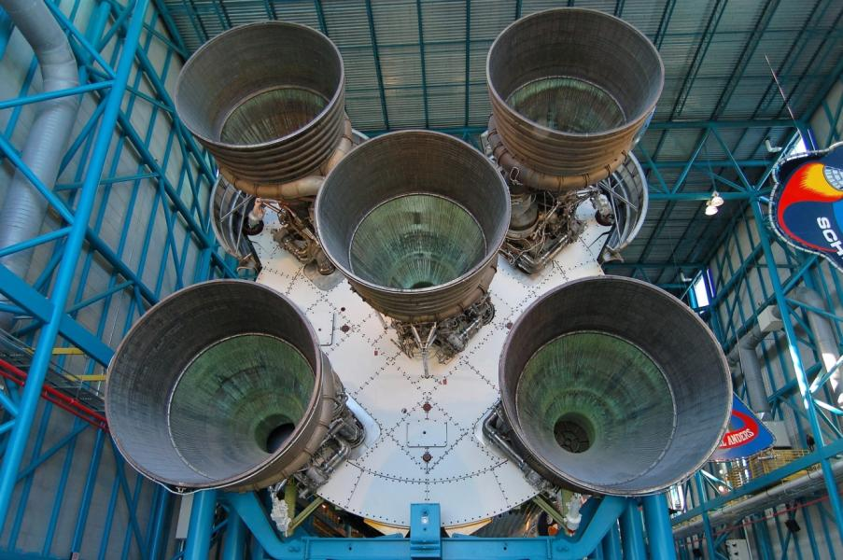
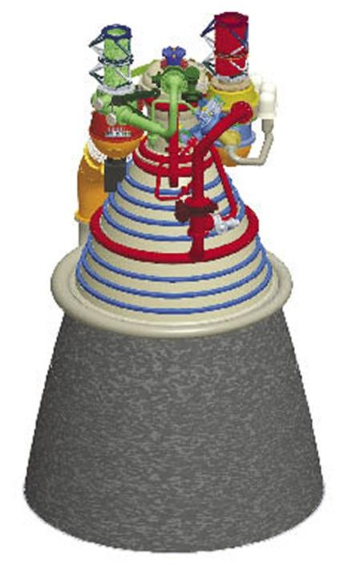
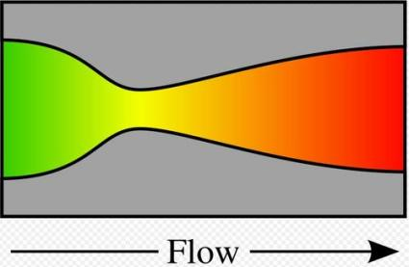
Bell Nozzles

Slide 4
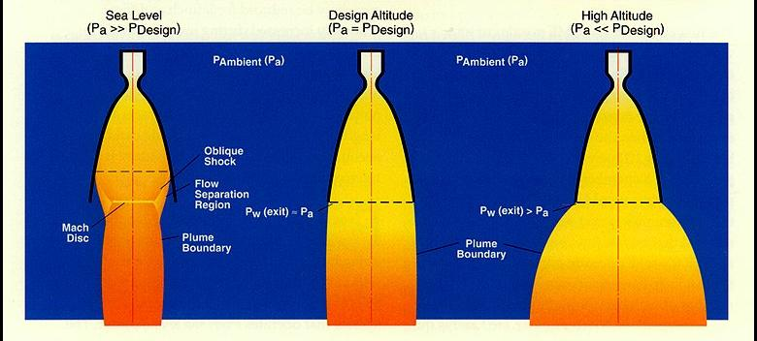
Bell Nozzle Expansion Modes
The traditional bell-shaped nozzle has a fixed geometry that is only able to expand exhaust gas to one fixed pressure

Slide 5
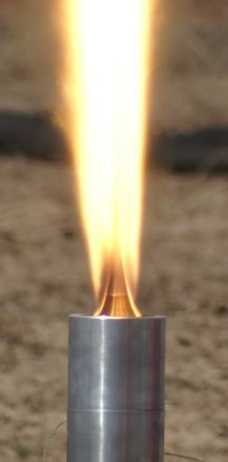
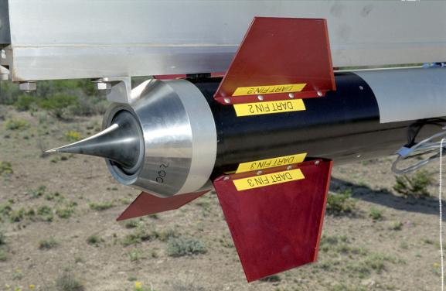
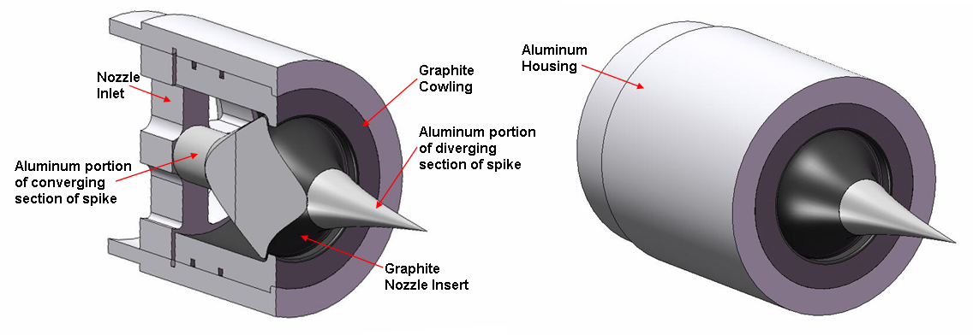
Aerospike Nozzles

Slide 6
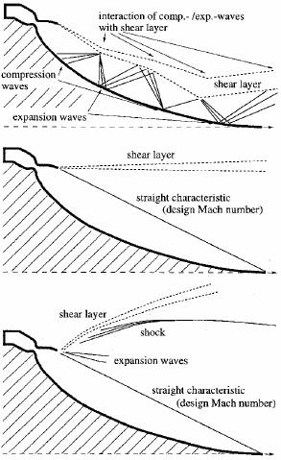
Aerospike Nozzle Expansion Modes
The aerospike nozzle’s expansion section is open to ambient atmosphere
The aerospike nozzle expands the exhaust gas to ambient air pressure at all altitudes below a design altitude
P_{a} > P_{design}
P_{a} = P_{design}
P_{a} < P_{design}

Slide 7
The Aerospike Advantage
Because atmospheric pressure decreases with altitude, sustained perfect nozzle expansion during flight within the atmosphere results in:
Increased Thrust, Total Impulse, Specific Impulse
This results in increased apogee altitude or payload weight
In order to quantify the advantage of using an aerospike nozzle, a numeric model was created to simulate terrestrial rocket flights

Slide 8
The Numerical Model
Uses basic Newtonian kinematics and aerodynamic drag
Based on a arbitrary rocket built around the STAR 27 Apogee Motor
The expansion ratio and burn time is varied to investigate its effect
Assumptions:
Coefficient of Drag = 0.2
Exhaust gas ratio of specific heats γ = 1.4
No flow losses in either nozzle; aerospike operation is ideal
Rocket flight is straight up and straight down
Stable weather conditions

Slide 9
Results: Altitude vs. Time Plots
Expansion Ratio = 2
Expansion Ratio = 25

Slide 10
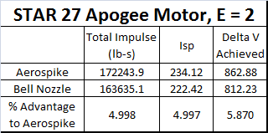
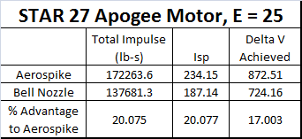
Results: Tables
Expansion Ratio = 2
Expansion Ratio = 25

Slide 11
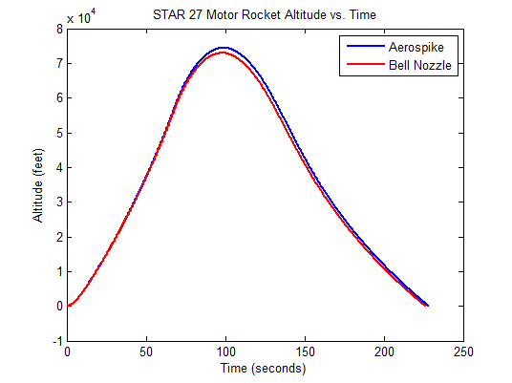
Results: Doubled Burn Time
Expansion Ratio = 5, Burn Time = 34.35
Expansion Ratio = 5, Burn Time = 68.7 sec

Slide 12
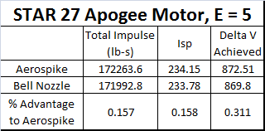
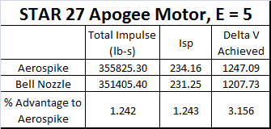
Results: Doubled Burn Time
Expansion Ratio = 5, Burn Time = 34.35
Expansion Ratio = 5, Burn Time = 68.7 sec

Slide 13
Conclusions
The increase in performance due to an aerospike nozzle depends heavily on two factors
The expansion ratio of the bell nozzle being compared to the aerospike nozzle
There is an optimum expansion ratio for the bell nozzle that maximizes its performance, which still falls short of the aerospike nozzle performance
The burn time of the rocket motor
The longer the burn time, the greater the performance advantage of the aerospike nozzle
Doubling the burn time increases the aerospike performance advantage by a factor of 10

Slide 14
Conclusions
The advantage of the aerospike is fairly marginal at the chosen burn times when compared to the optimum bell nozzle expansion ratio
It may be difficult to justify the time and cost necessary to bring the aerospike to operational status
Suggested applications:
Extremely long (> 2mins) burn times
Extremely large expansion ratios (> 100) for use in space, where p_{a} → 0

Slide 15
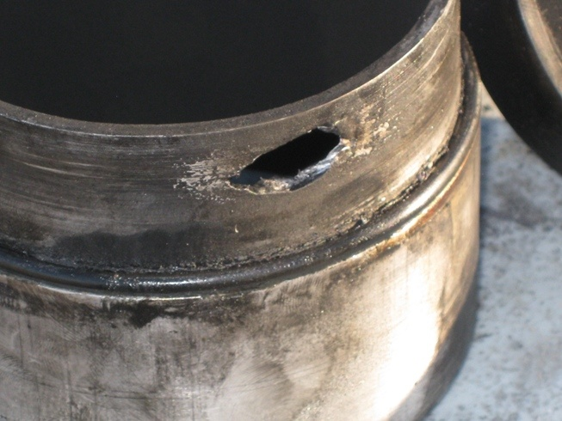
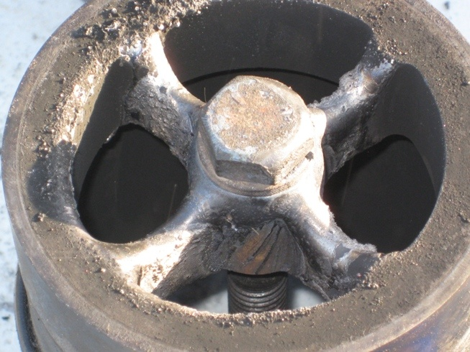
Future Work
Daedalus Astronautics @ ASU is currently conducting research on aerospike nozzles, and plans to incorporate them into high-powered sounding rockets
The numerical model will be used to predict the rocket’s performance
One big hurdle: achieving long burn times in student-build rocket motors without structural failure

Slide 16
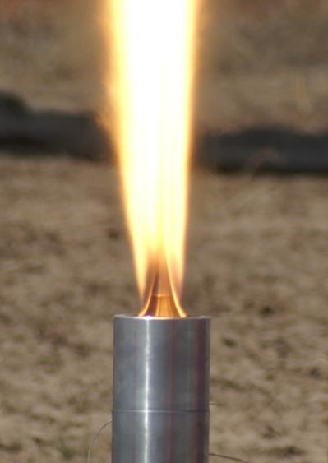
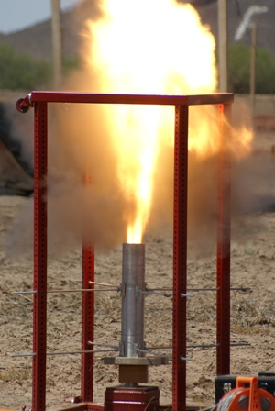
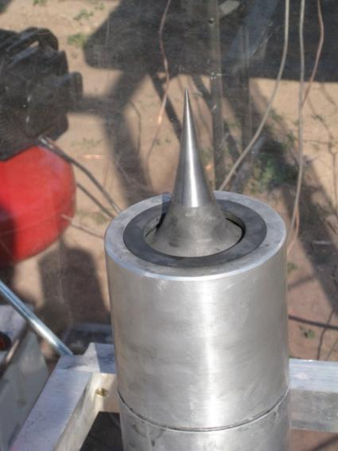
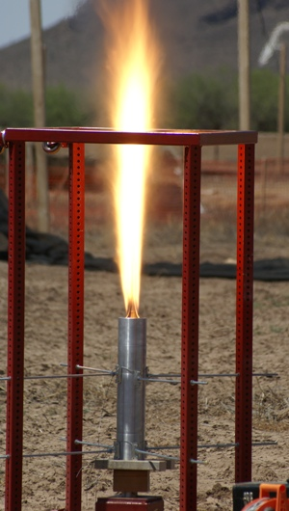
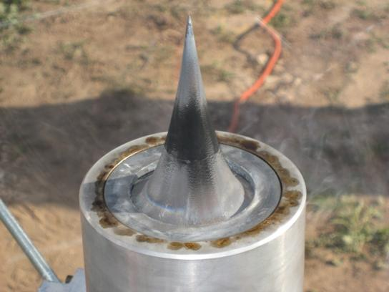
Questions?

